Slide 1

Freenet as a broker for „Medical“ IoT Data
Bachelor thesis– Bern University of Applied Science
18.06.2021
Student: Yannick Stebler
Professor: Prof. Dr. Emmanuel Benoist
Expert: Daniel Voisard

Slide 2
Index
Topic – Problem definition
Goals
Freenet (Broker)
Architecture
Attacks
Conclusion
Questions

Slide 3
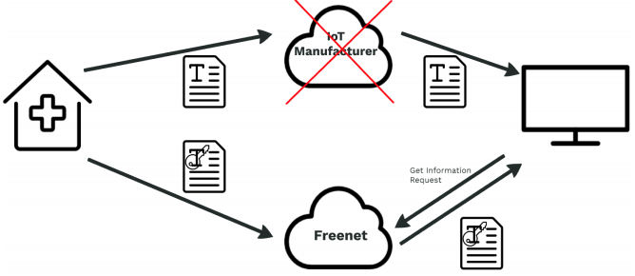
Topic - Problem definition
IoT devices are on the rise
Many make everyday tasks easier
Same problem for all of them
Data Exchange via manufacturer
Dependency to the manufacturer
In case of bankruptcy device useless
=

Slide 4
Goals
Define new communication path
Largely anonymous communication
Protect the exchange of data
Data access only for authorized parties
Document the architecture of the new communcation path
Implement it in a small prototype
IoT sending device programmed with C
Receiver programmed with C#

Slide 5

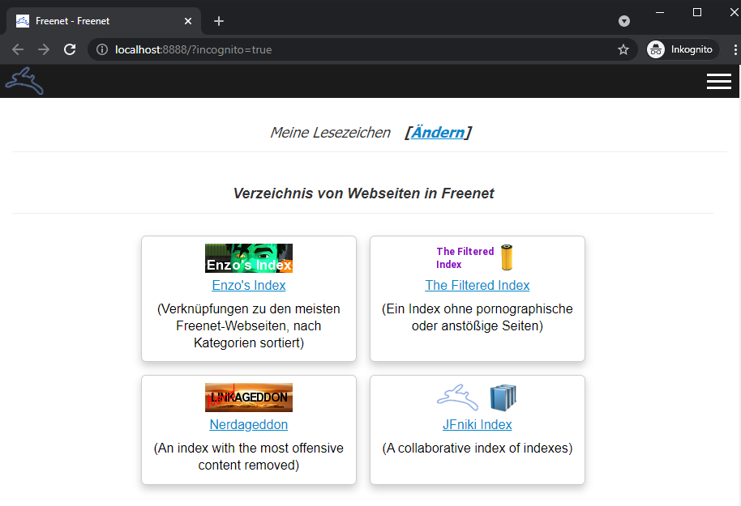
Freenet (Broker)
Free software
Peer-to-peer platform for censorship-resistant communication
Share files, browse and publish „freesites“ and chat on forums
Encrypted communication
Contribute to the network with bandwith and a portion of hard drive storage
Is used as Broker in my Thesis
More information on: https://freenetproject.org

Slide 6
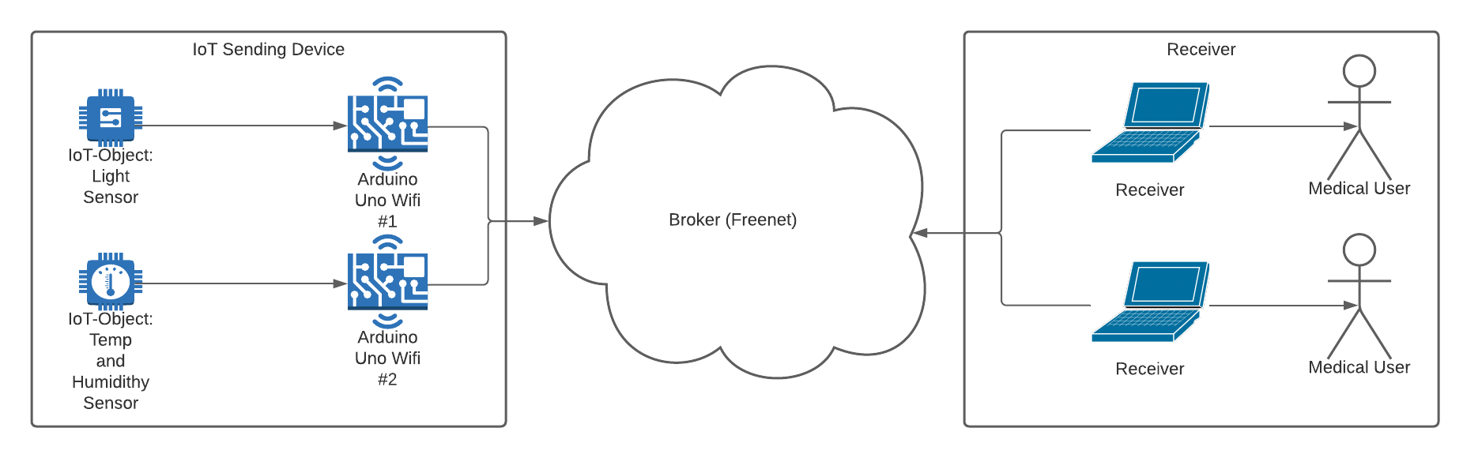
Architecture – Overview

Slide 7
Architecture – Initialisation 1
Freenet uses his own Protocol FCP – Freenet Client Protocol
Input limitation of small IoT device
Scratchable QR-code of upload URI (Path)
URI (USK – Updateable Subspace Key) Example – Generated by Freenet
USK@VuHdPK~~8ArRcYhGU7JlibgTKSrnxLRH4jR1PCiHrUU,9SFpiAvN3pBYHyY~OSkwIk7wU33WYIU3a7Rt1fdmz~8,AQECAAE/temp/1

Slide 8
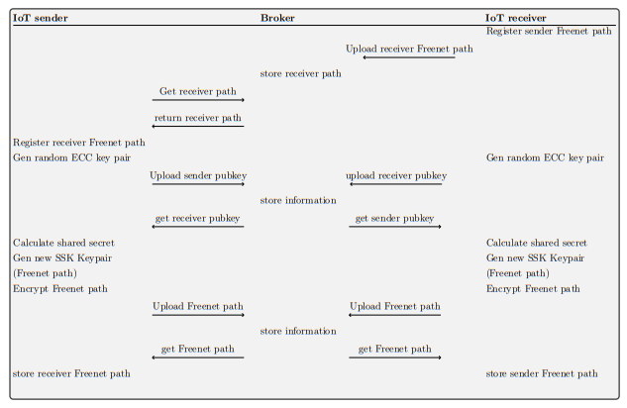
Architecture – initialization 2
Steps:
Scan QR-Code Sender on Receiver
Register Receiver URI on Sender
Both generate ECDH Keypair
Exchange Public Keys
Calculate Shared Secret and Generate new URIs
Exchange Encrypted URIs

Slide 9
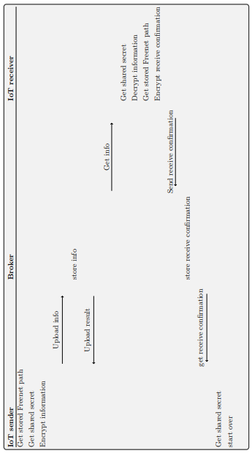
Architecture – Data transmission
Steps:
Sender get stored information
Read sensor data
Encrypt sensor data and upload
Receiver download data
Decrypt sensor data
Send receive confirmation to sender

Slide 10
Attacks and Prevention
Spoofing of the data
Interruption of the data flow by flooding Freenet
Phyiscal attack on IoT sender
Physical attack on Freenet Node Hardware

Slide 11
Conclusion
Deffined / Developed a new communication path
Anonymous and protected communication implemented
Was a very demanding work
Still a lot of room for improvement (Prototype)
Was able to put many theoretical learnings into practice

Slide 12

Questions

